Slide 1
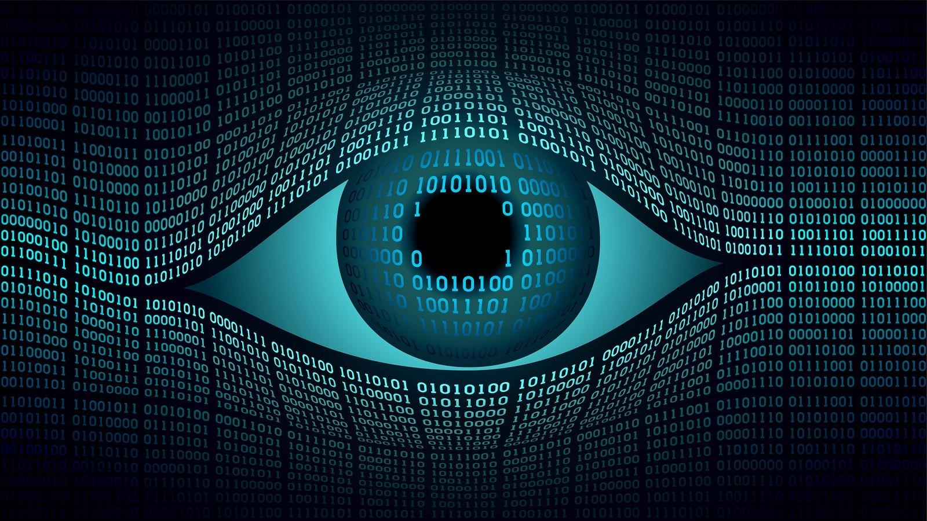
Computer Vision
By: Fletcher, Kusha, and a sprinkle of Olly
Notes:
Fletch

Slide 2
Pop Question: Chihuahua or Muffin?
Notes:
Fletch

Slide 3
What is CV?
The field of Computer Science that deals with understanding visual elements such as images or videos.
Seeks to perform tasks humans can accomplish visually
Closely related to animation and simulated Physics!
Notes:
Fletch

Slide 4
Tasks like …
Object classification
Face recognition
Motion Capture
3D scene reconstruction
Image Segmentation
Background/Foreground Detection
Notes:
Olly

Slide 5
Tasks like …
Object classification
Face recognition
Motion Capture
3D scene reconstruction
Image Segmentation
Background/Foreground Detection

Slide 6
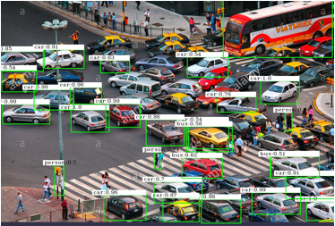
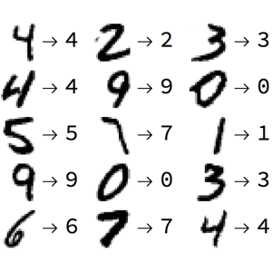
Notes:
Olly

Slide 7
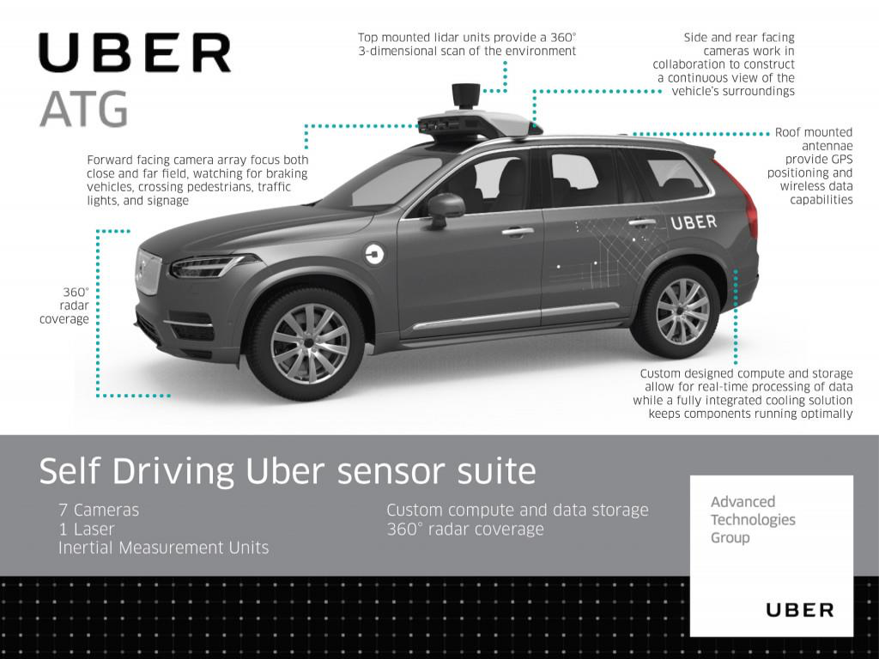

Slide 8
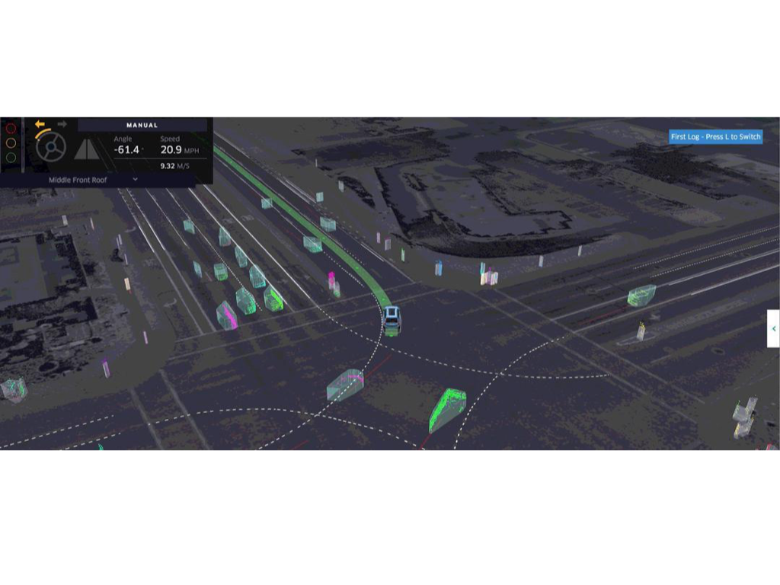

Slide 9
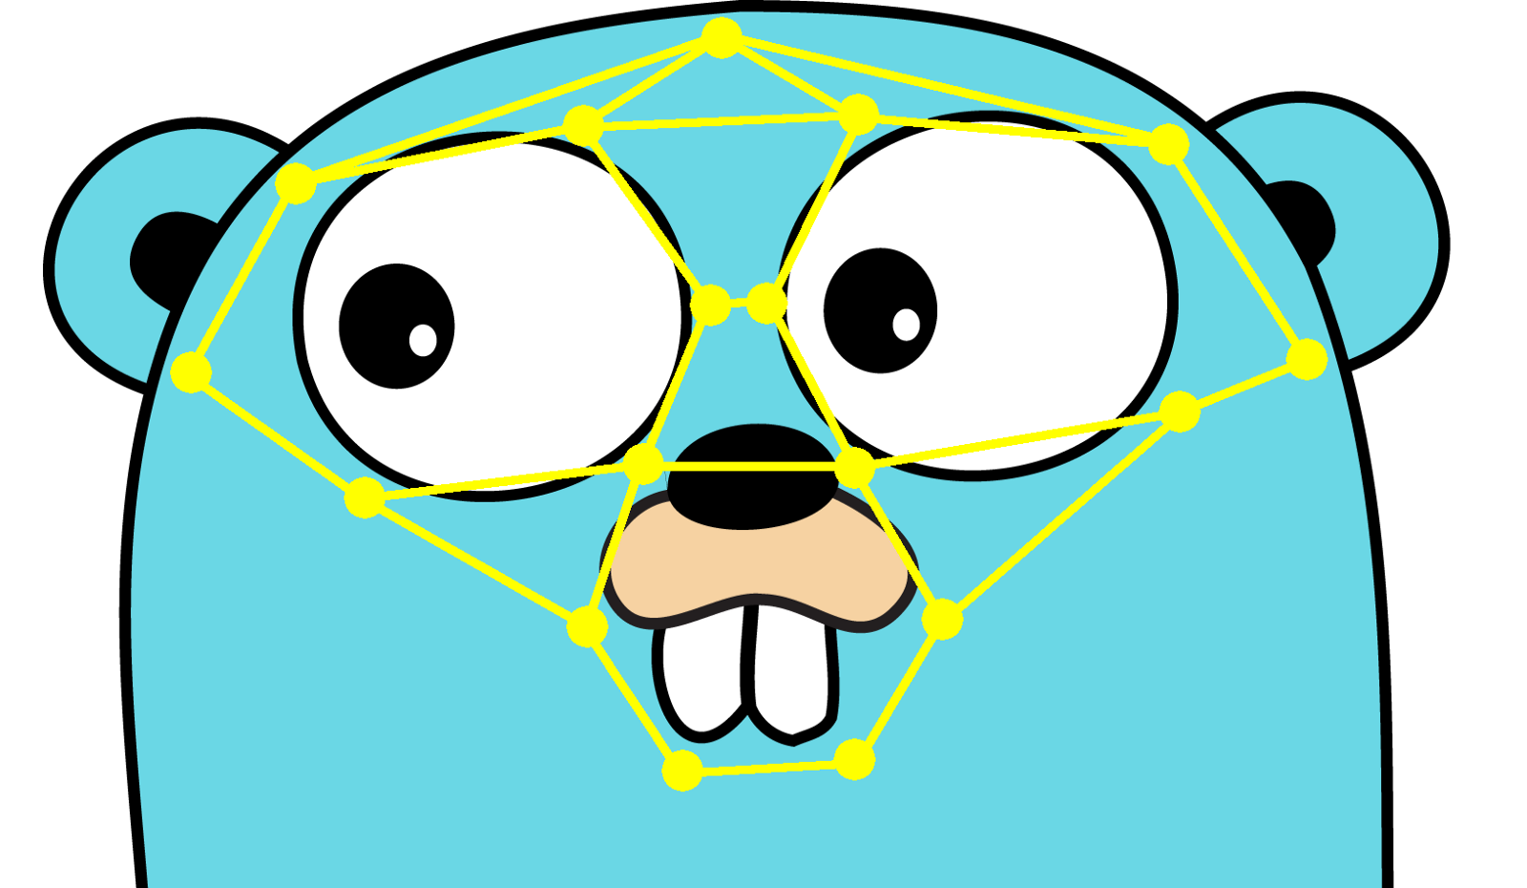
Tasks like …
Object classification
Face recognition
Motion Capture
3D scene reconstruction
Image Segmentation
Background/Foreground Detection
Notes:
Fletch

Slide 10
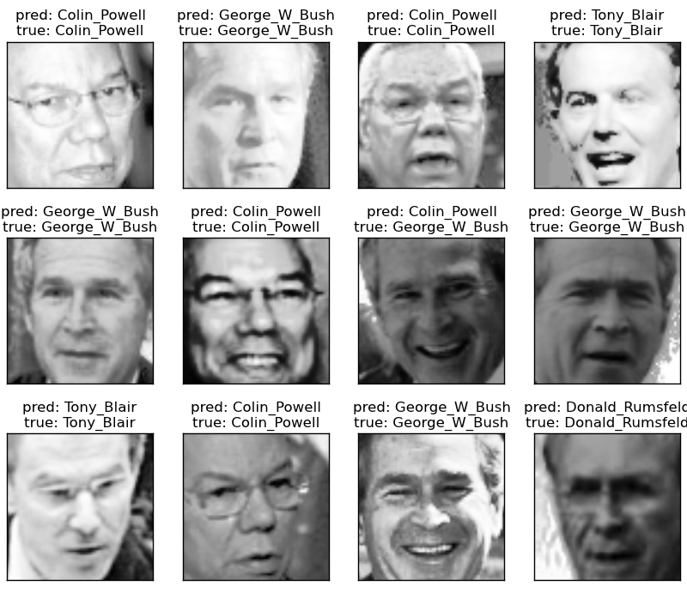
Notes:
Fletch

Slide 11
Masks!
A really common one: Gaussian Blur!

Slide 12
Cascade: Masks used in succession to help recognize things
Example: Haar Cascades!

Slide 13
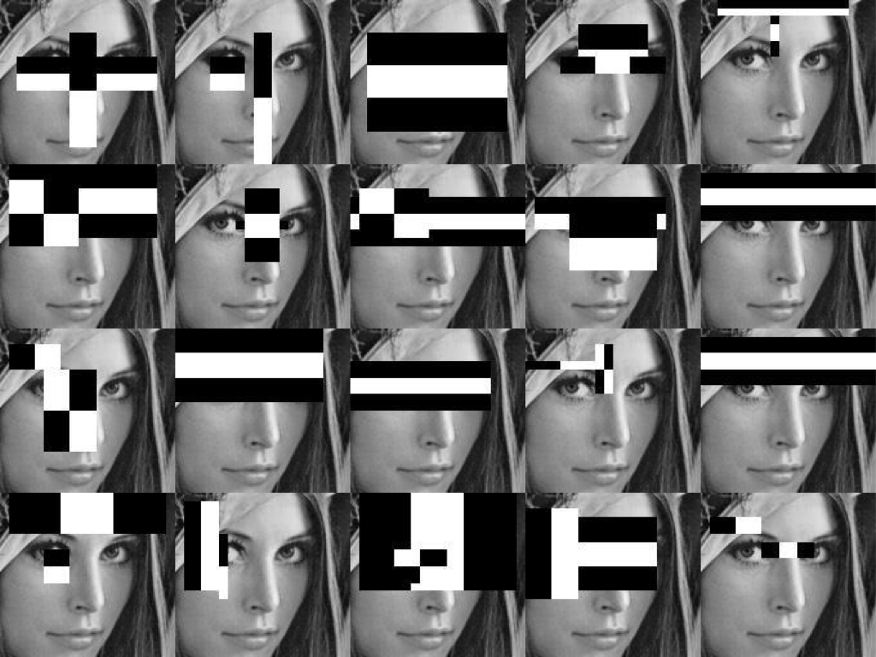

Slide 14
Tasks like …
Object classification
Face recognition
Motion Capture
3D scene reconstruction
Image Segmentation
Background/Foreground Detection
Notes:
Olly

Slide 15
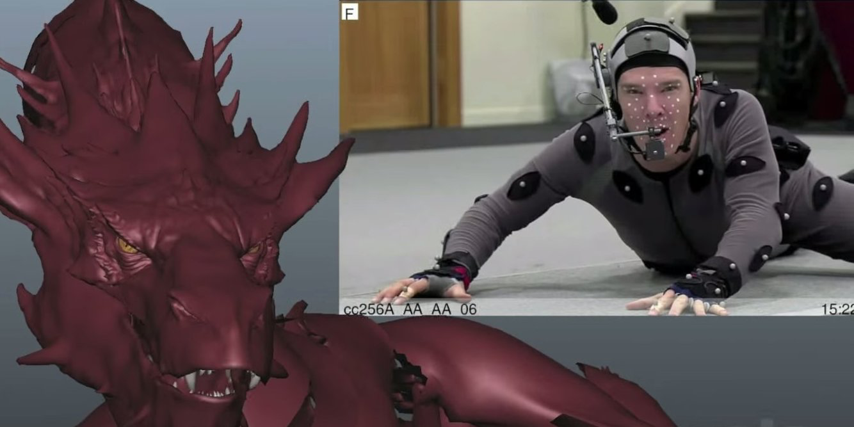
Notes:
Olly

Slide 16
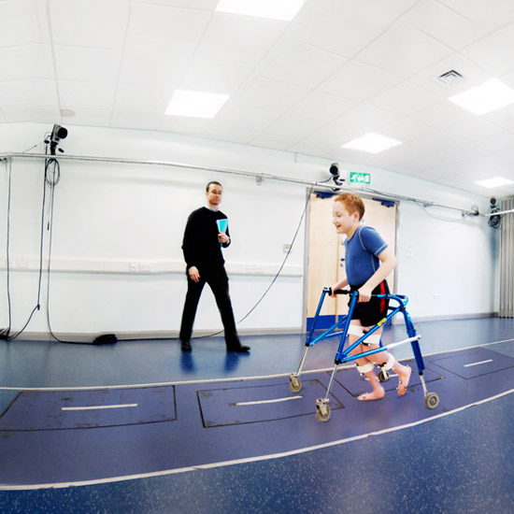
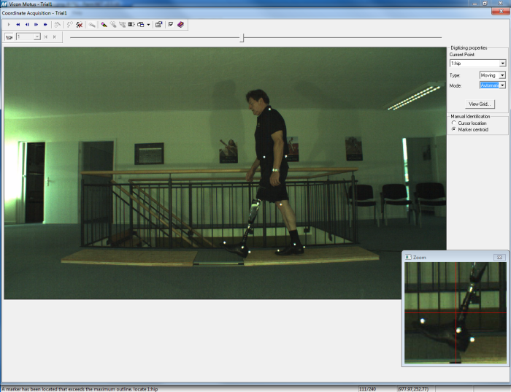
Notes:
Olly

Slide 17
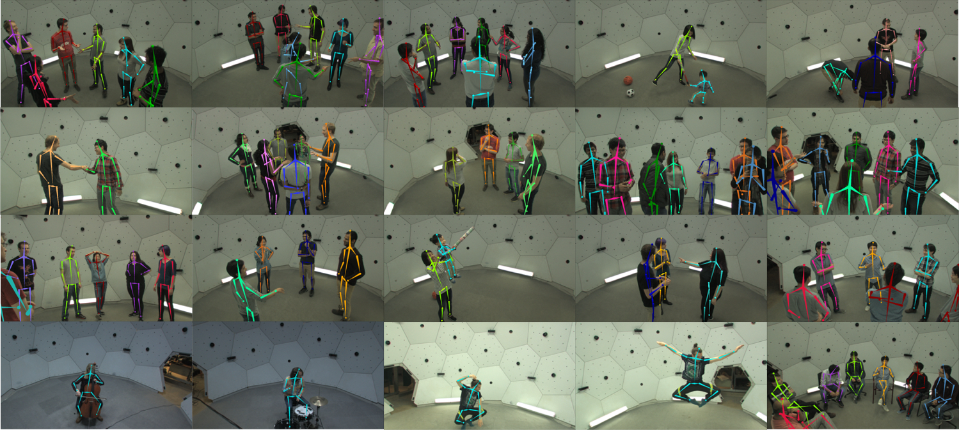
Notes:
Olly

Slide 18
Tasks like …
Object classification
Face recognition
Motion Capture
3D scene reconstruction
Image Segmentation
Background/Foreground Detection
Notes:
Fletch

Slide 19
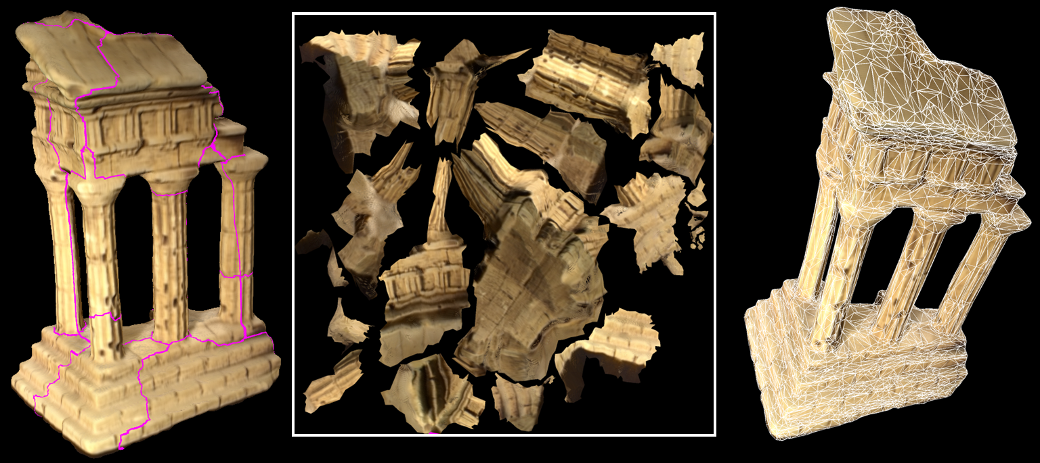
Notes:
Fletch

Slide 20
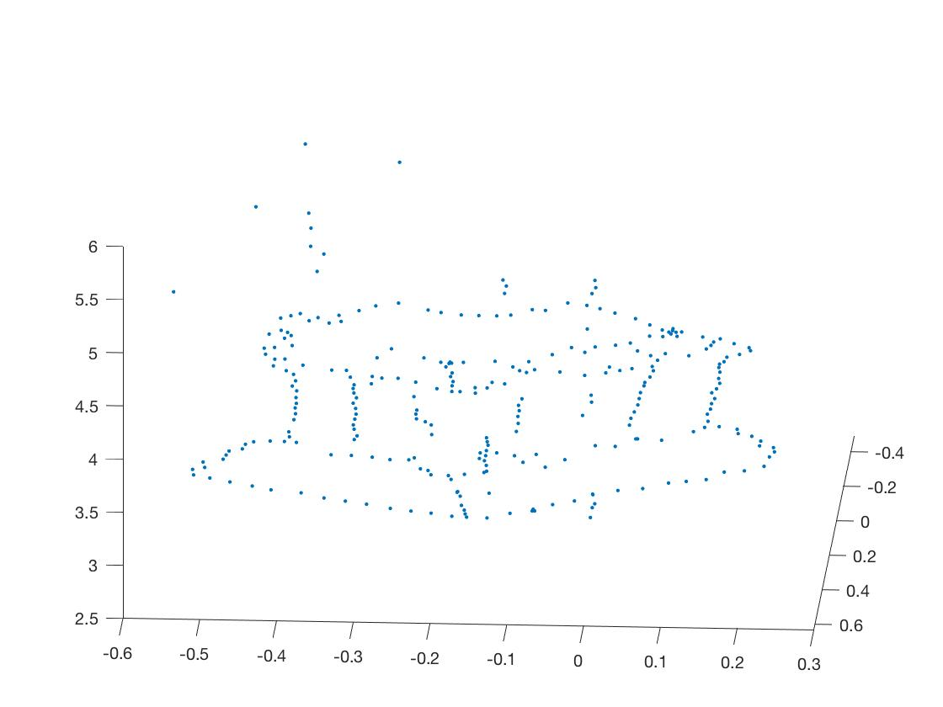
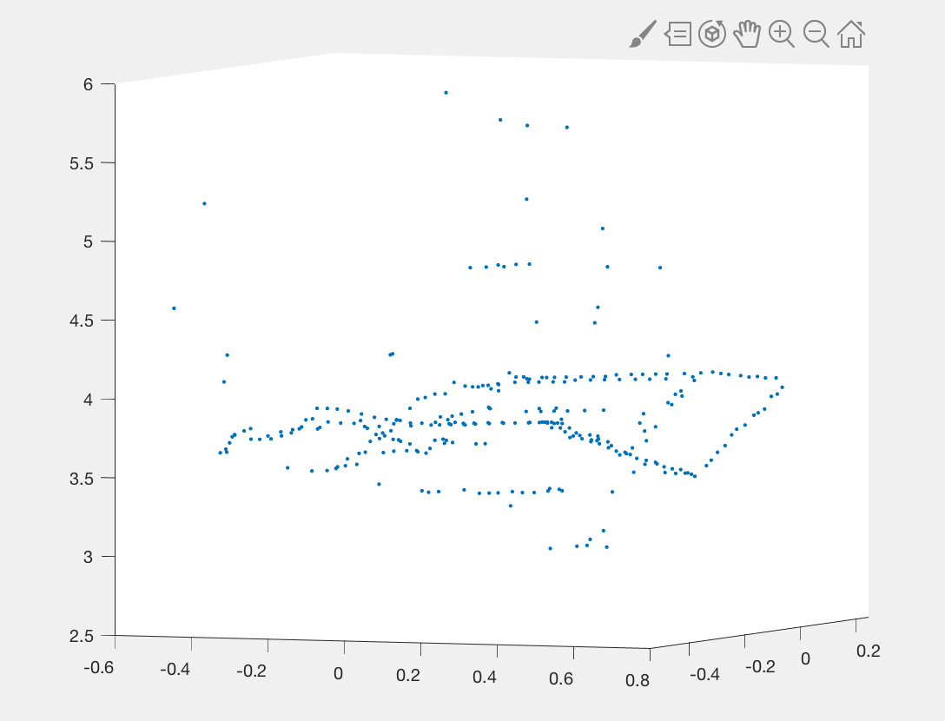
Point Clouds
We can recreate environments from pictures!

Slide 21

Tasks like …
Object classification
Face recognition
Motion Capture
3D scene reconstruction
Image Segmentation
Background/Foreground Detection
Notes:
Olly

Slide 22
Tasks like …
Object classification
Face recognition
Motion Capture
3D scene reconstruction
Image Segmentation
Background/Foreground Detection
(More on this in a bit)
Notes:
Olly

Slide 23
Tasks like …
Object classification
Face recognition
Motion Capture
3D scene reconstruction
Image Segmentation
Background/Foreground Detection
Notes:
Fletch

Slide 24
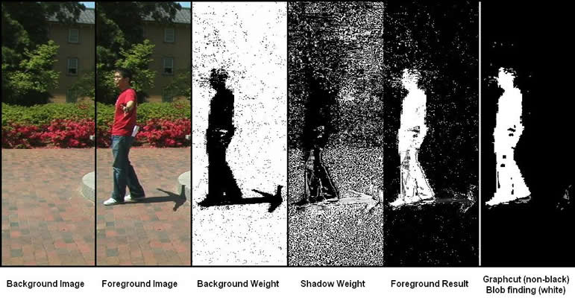
Notes:
Fletch

Slide 25
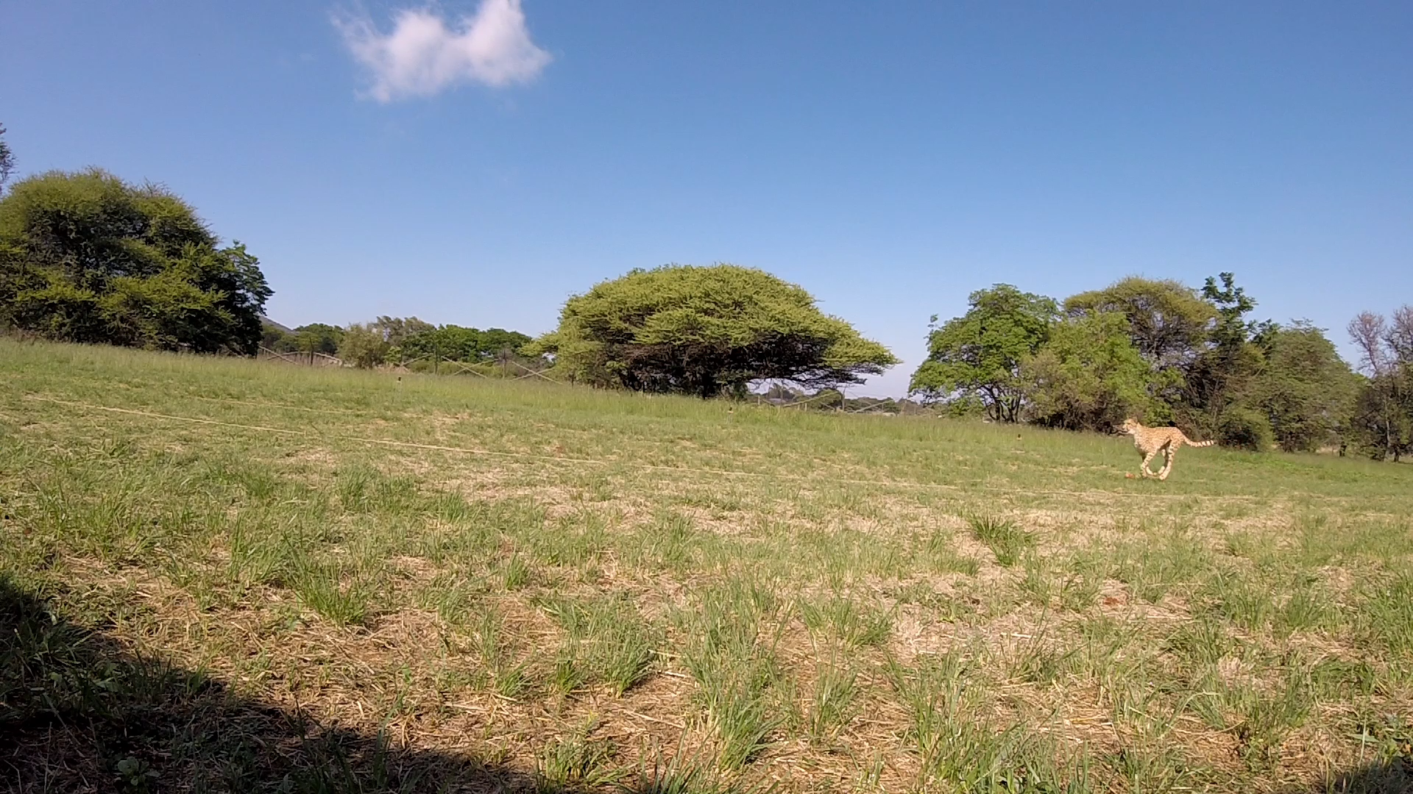

Slide 26


Slide 27
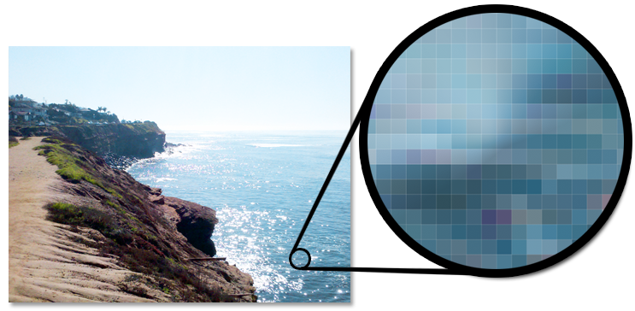
A Quick Chat About Pxiels!

Slide 28
RGB vs. Grayscale
RGB: Red, Blue, Green components in range (0-255)
(0, 0, 0) -> Black
(255, 255, 255) -> White
Grayscale: Just gray level
0 to 255 (Black -> White)

Slide 29
For general CV tasks…
Grayscale makes things much easier!

Slide 30
Back to background detection: how can we understand what is/isn’t the background of a picture?
Pseudocode:
For every picture in our set of pictures, calculate the ’sum’ of every pixel
Divide the sums by the number of images to get average values at each pixel
For every picture in our set, if we see a significant deviation from the average, we know that is foreground – it does not closely match the background average

Slide 31
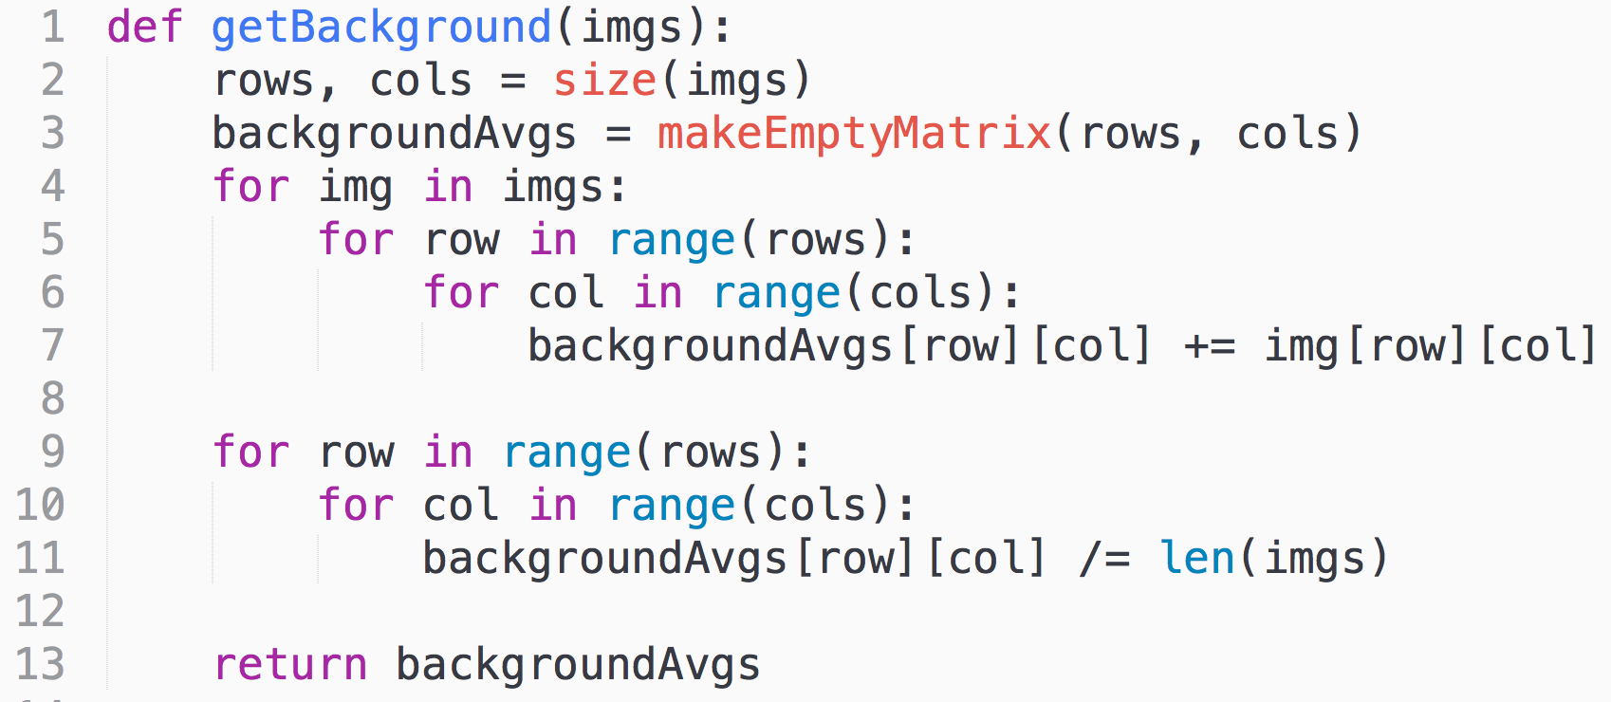
(Inefficient) Python:

Slide 32
All those 2D list free response questions,
we teach them for a reason!

Slide 33
Now let’s do some worked examples!

Slide 34
Image Segmentation
Literally, just partitioning an image into multiple segments based on your needs

Slide 35
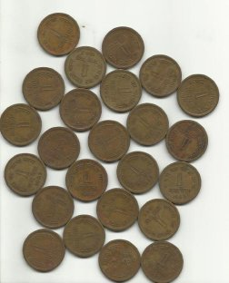

Finding what is (and isn’t) a penny!

Slide 36
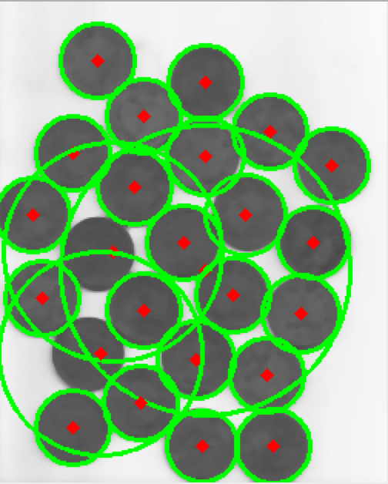
Next worked example: Detecting circles
Note the false positives! A lot of the work involves fine tuning the parameters.

Slide 37

Cool experiment, what happens when we run this on images with not-quite-circles?

Slide 38
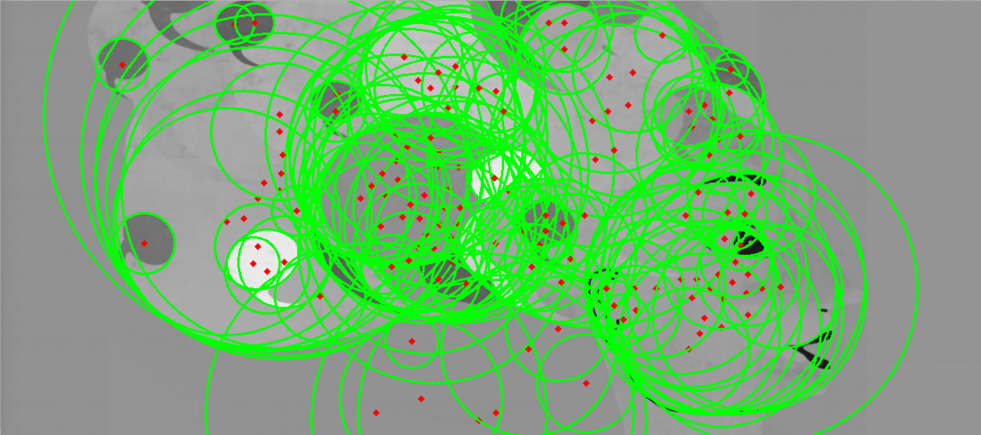
Cool stuff!

Slide 39
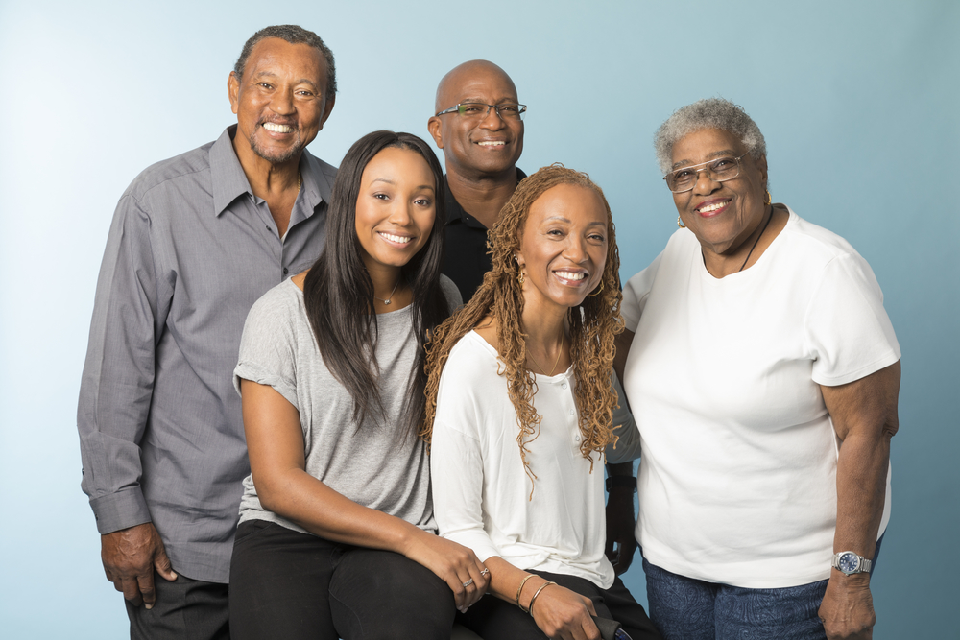
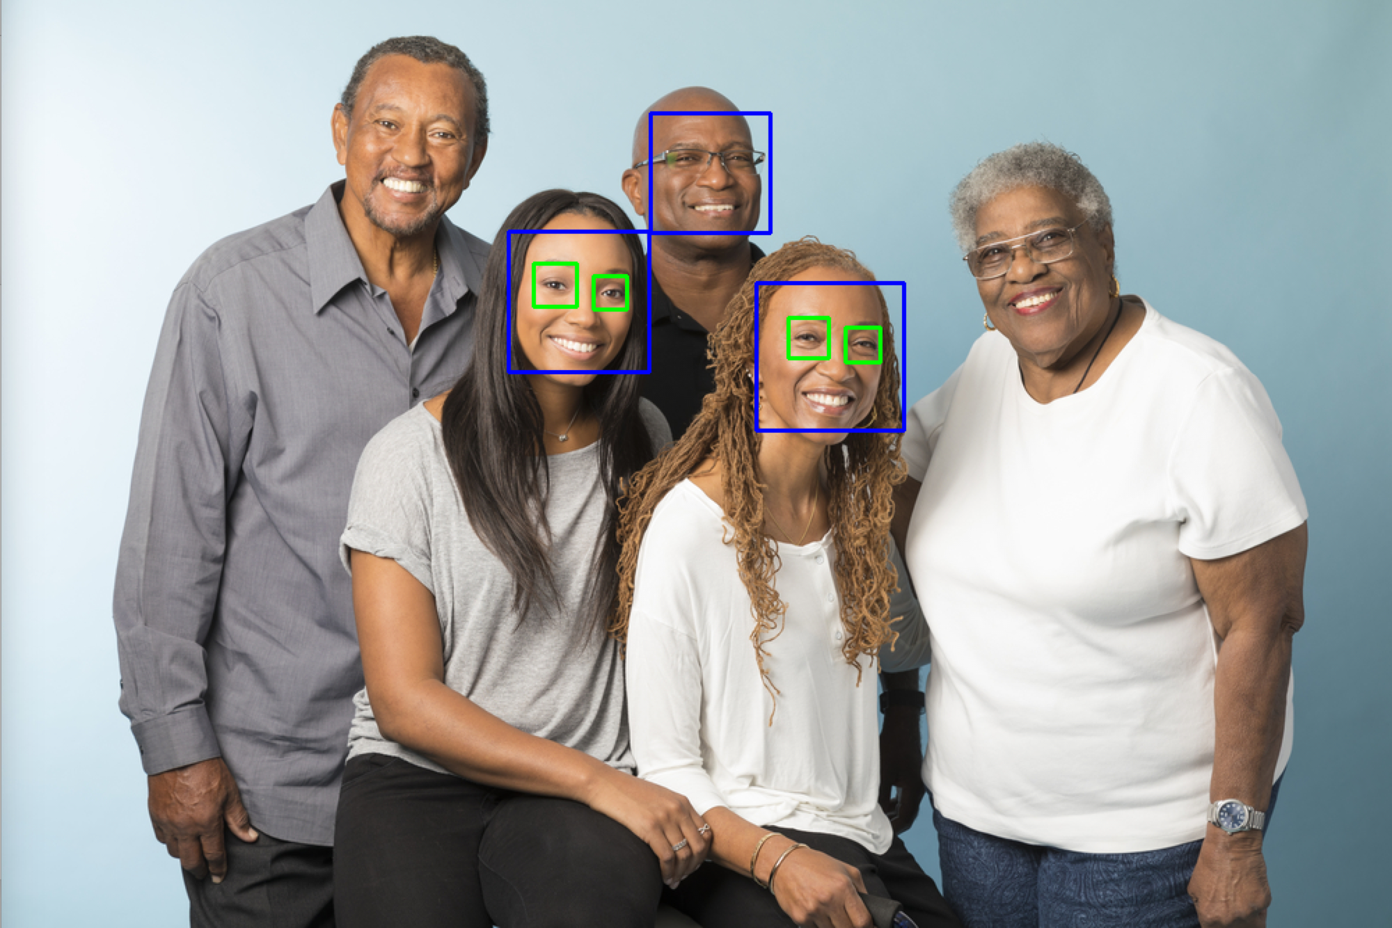
Last worked example: Detecting faces
Note the false negatives! Again, tune the parameters.

Slide 40
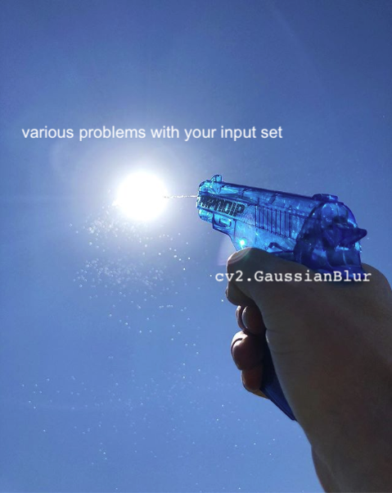
Lastly, a quick meme:

